Slide 1

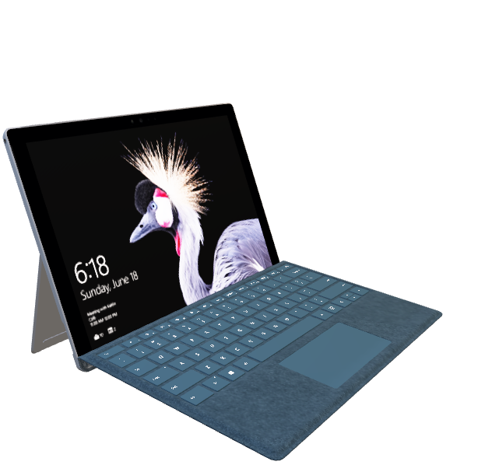
PROJECT ON CSE310: JAVA
Title:
Holistic strategy aimed at optimizing overall health and lifespan
based on BMI(Body Mass Index)

Slide 2
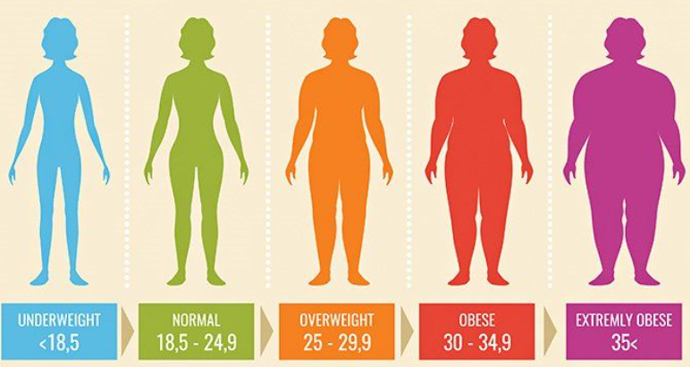
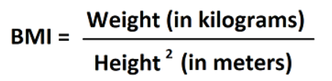
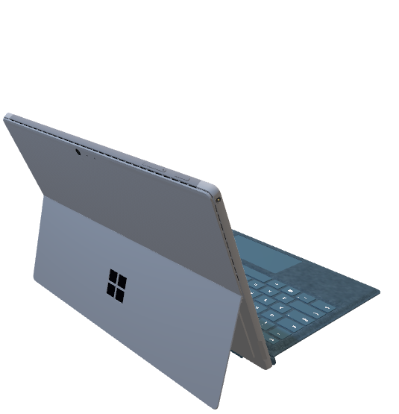
INTRODUCTION
The body mass index (BMI) is a measure that uses your height and weight to work out if your weight is healthy.
BMI(Body Mass Index) is a person’s weight in kilograms (or pounds) divided by the square of height in meters (or feet).
A high BMI can indicate high body fatness.
BMI screens for weight categories that may lead to health problems, but it does not diagnose the body fatness or health of an individual.
Range : Underweight-Below 18.5 .
Healthy-Between 18.5 and24.9.
Overweight-Between 25.0 and 29.9.
Obese- Between 30.0 and 34.9.
Extremely Obese- Above 35
Formula:

Slide 3

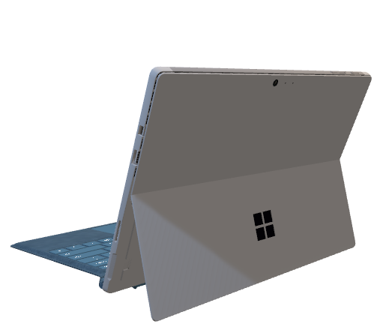
PROBLEM STATEMENT
Diet: Taking of unproper diet.
Physical Activity: Lack of physical activity.
Genetics: There are some genes associated with obesity and
overweight. In some people genes can affect how
their bodies change food into energy and store
fat.
Medical Reasons: In some cases, underlying medical
conditions may contribute weight gain.
These include
an underactive thyroid gland(hypothyroidism)– where your thyroid gland does not produce enough hormones
Crushing’s syndrome- a rare disorder that causes the over -production of steroi hormones

Slide 4
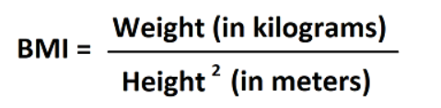
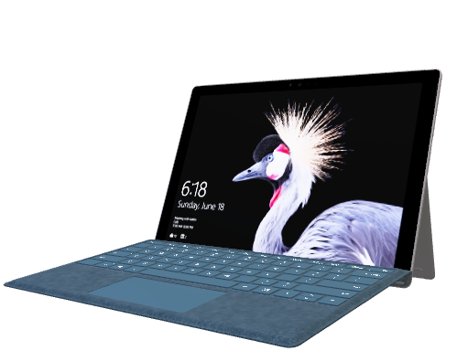
PROPOSED TECHNIQUE
To solve this unhealthy BMI, we designed a program to calculate BMI and provide tips to keep our BMI in the perfect range.
In this program, there will be a interface of registering our personal details at first.
After registering, we will be directed to a interface for entering our height, age, weight, etc. to calculate our BMI.
The code will be taking the inputs from that interface and will calculate the BMI.
The formula for BMI calculation is
We will know our BMI health from this and there will be tips for keeping our BMI in the perfect ratio.

Slide 5
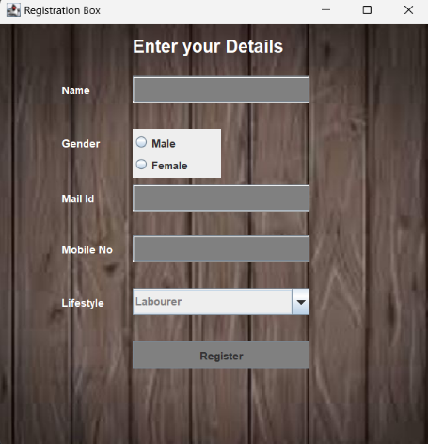
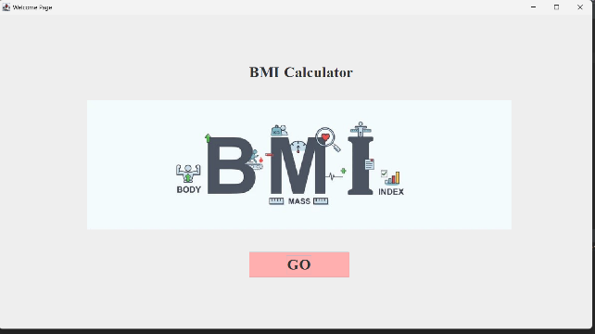


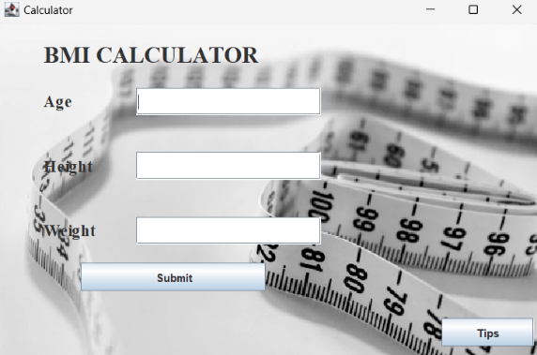
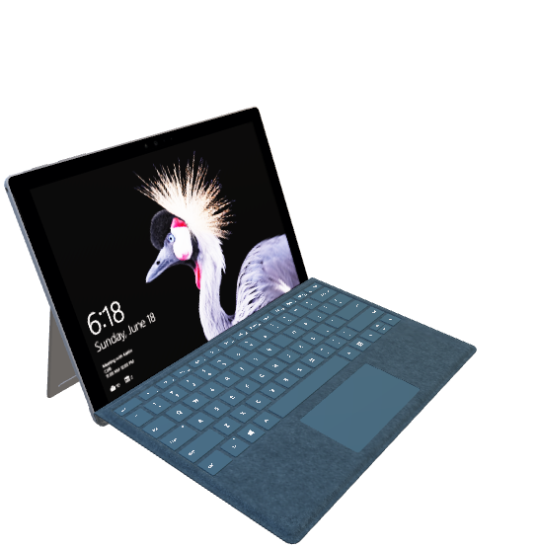
OUTPUTS
Register page
Welcome page
Calculation page

Slide 6
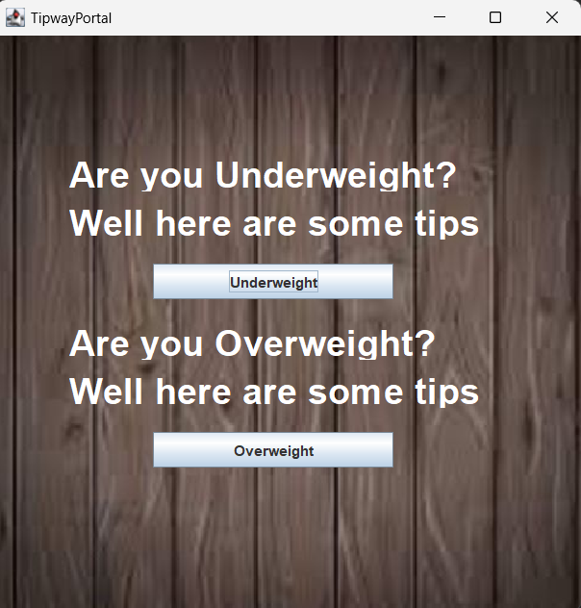
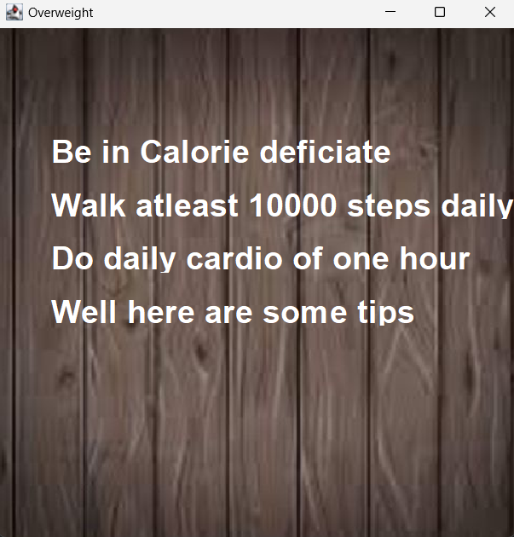
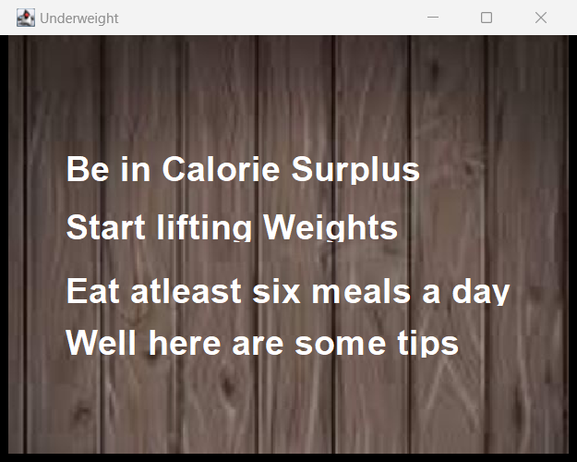
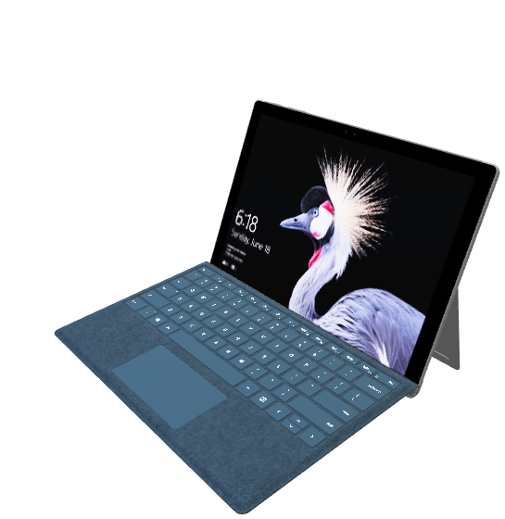
Tips page
Overweight
Underweight

Slide 7


CONCLUSION
This project creates a user-friendly interface for data input and output, implementing the BMI formula in Java code, and handling potential errors or invalid inputs.
This project will let the users able to calculate their BMI.
By knowing their own BMI, they can work on that to improve their health and live a healthy live as we have provided tips for both underweight and overweight.

Slide 8

Thank you

